Slide 1

HOSPITAL MANAGEMENT SYSTEM
47-Madhuri Patil.
49-Durva Patkar.
57-Vaishnavi Rawate.

Slide 2

Problem Statement
The current manual or outdated system for managing birth and OPD records in hospitals leads to data inaccuracies, inefficiency, and delays in patient care. Manual processes are prone to errors, making it difficult to ensure compliance with legal requirements like birth certificates. Additionally, physical records are at risk of loss or damage, compromising data integrity. The lack of a centralized, digital system results in slow information retrieval and operational inefficiencies. Ensuring the security and privacy of sensitive patient data is also a challenge in these traditional systems.The Hospital Management System aims to address these issues by providing a digital solution that offers accurate, efficient, and secure management of hospital records and workflows.

Slide 3
INTRODUCTION
A Hospital Management System (HMS) is software that simplifies managing patient records, hospital workflows, and data across different departments. It helps improve coordination, healthcare delivery, and patient care by digitizing records like births and OPD visits, reducing paperwork, and ensuring secure access to patient information.
Birth Record Management: Helps record birth details, store birth certificates, and manage legal documents.
OPD (Outpatient) Record Management: Tracks patient visits, diagnoses, treatments, prescriptions, and follow-up appointments.
Billing and Finance: Manages billing, invoicing, and insurance claims for outpatient and in-patient services.
Inventory Management: Monitors medical supplies, drugs, and equipment.
Laboratory and Diagnostics: Handles lab tests and diagnostic results for easy access by doctors.
Staff and Doctor Scheduling: Organizes work shifts, doctor appointments, and staff assignments.

Slide 4
OBJECTIVE
To streamline birth record management by automating the process of registering births, issuing certificates, and ensuring compliance with legal standards.
To manage OPD records efficiently, allowing easy tracking of patient visits, diagnoses, and treatments.
To enhance the overall patient experience by reducing wait times and providing faster access to medical records.
To secure sensitive patient data by implementing role-based access controls and encryption mechanisms.
To provide analytical insights for hospital management regarding patient trends, diagnoses, and operational efficiency.

Slide 5
ER DIAGRAM

Slide 6
SCHEMA DIAGRAM

Slide 7
SQL Commands and Queries
A Total of 36 SQL queries have been successfully performed on the database.

Slide 8
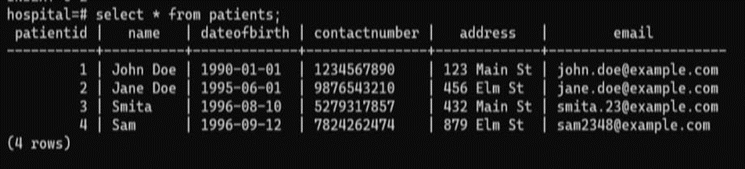
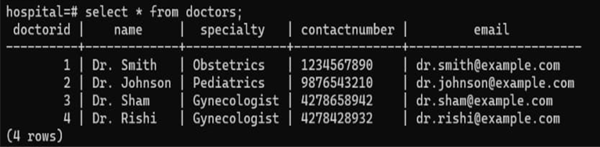
Patient Table
Doctor Table

Slide 9
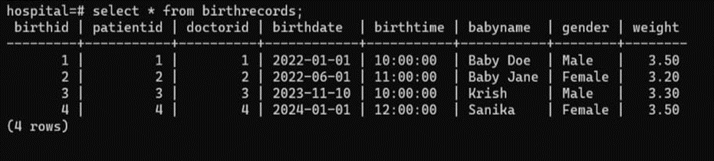
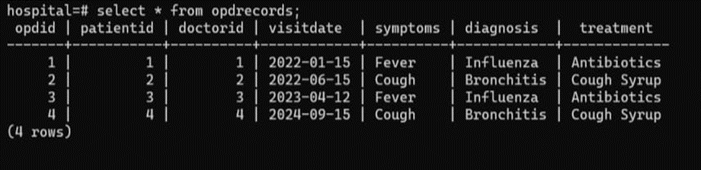
Birth Record Table
OPD Records Table

Slide 10
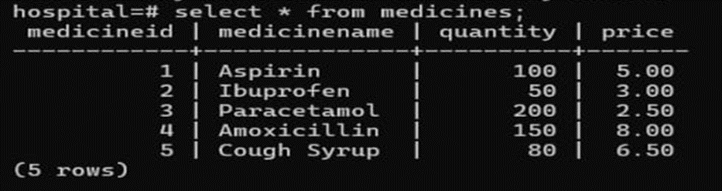
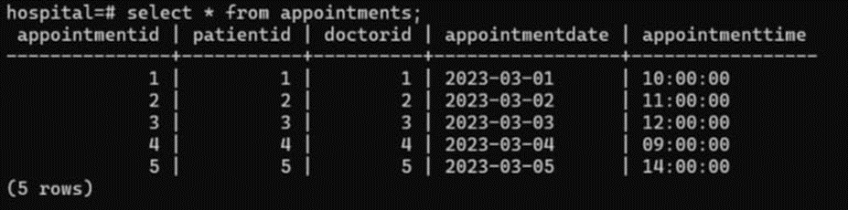
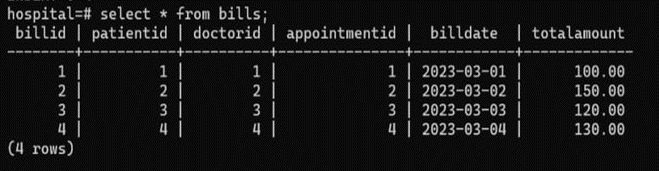
Medicines Table
Appointment Table
Bill Table

Slide 11
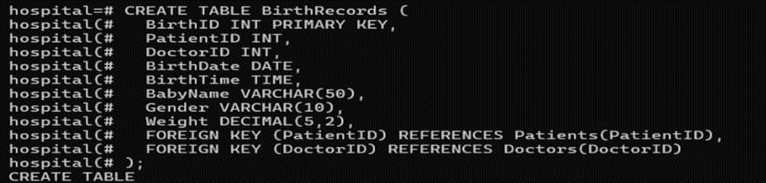
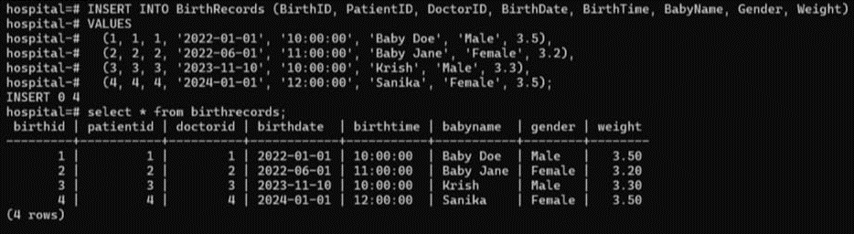
Basic Commands ( CREATE, INSERT, SELECT , DROP ):
Create table Birth Records.
Insert into Birth record table.

Slide 12
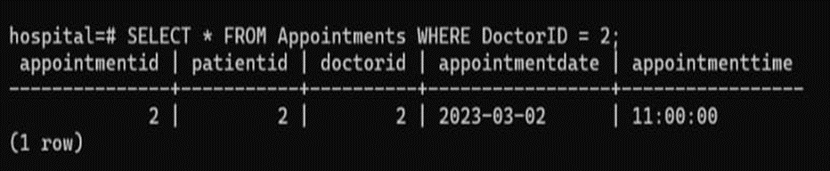
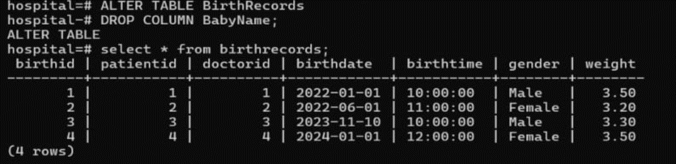
Elect from Appointment table where Doctor id is 2.
Drop the column baby name from Birth records table.

Slide 13
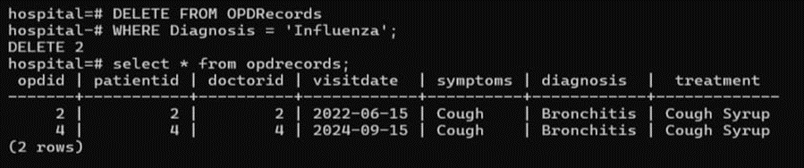
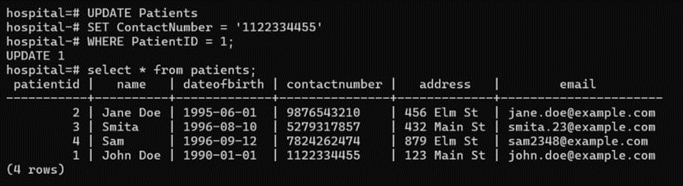
2. Modifying Commands (DELETE , UPDATE, ALTER , RENAME):
Delete from OPD records table where the patient has been diagnosed with Influenza.
Update the Patients Contact number whose Patient id is 1.

Slide 14
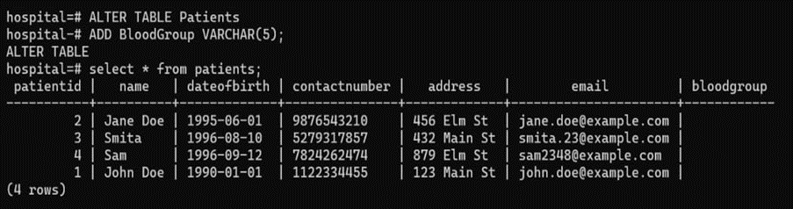
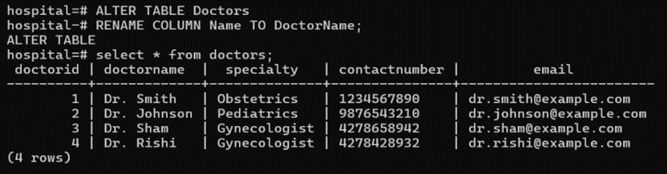
Alter Patient table to add a column of bloodgroup.
Rename the column name in doctor table to doctor name.

Slide 15
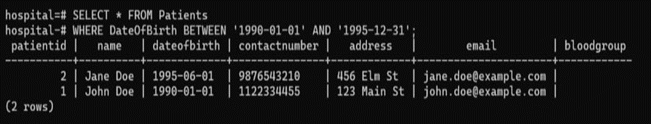
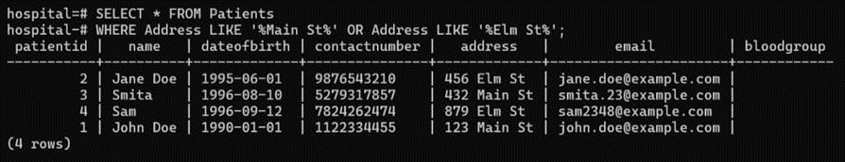
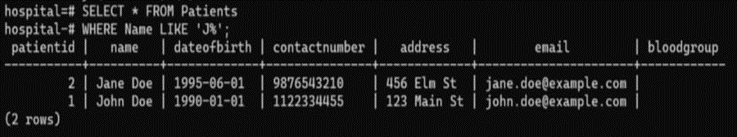
3. Compound Conditions (BETWEEN , AND , OR, LIKE, NOT LIKE).
..
Find all the patients whose Date of Birth is between 1990 and 1995.
Find the patient id whose weight is greater than 3.0 AND gender is male.
Find all patients whose name starts with J.

Slide 16
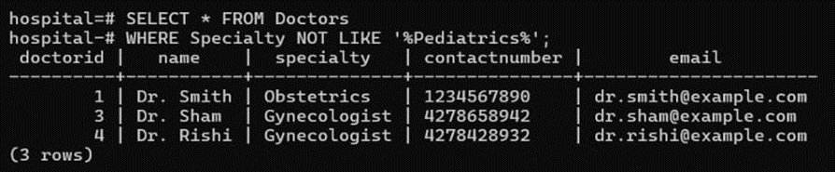
Find all doctors whose speciality does not contain Pediatrics.

Slide 17
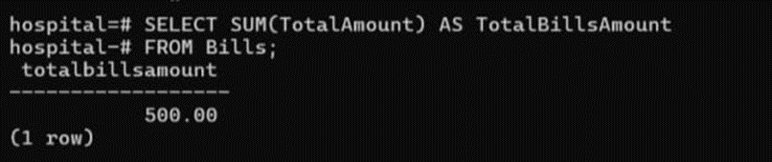
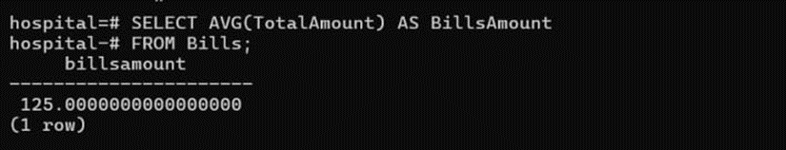
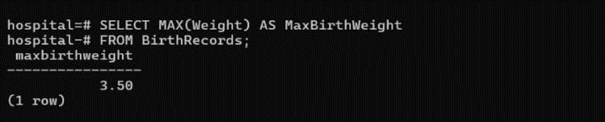
4. Aggregate Functions ( SUM, AVERAGE, MAX ,MIN, COUNT )
Calculate the total billing amount for all patients.
Find the average of total amout from the bills amount table.
Find the maximum weight in the Birth records table.

Slide 18
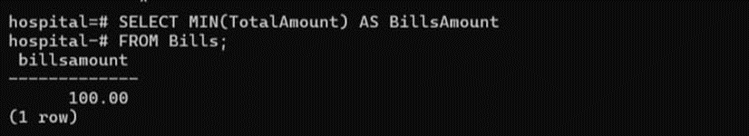
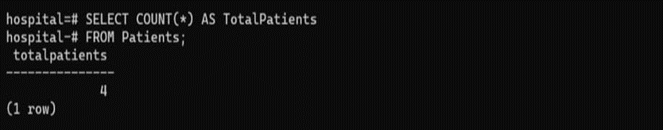
Find the minimum billing amount in the billing table.
count the total number of patients from the Patient table.

Slide 19
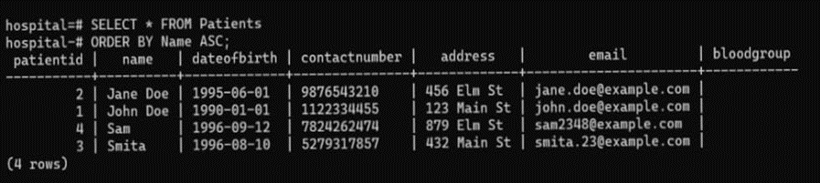
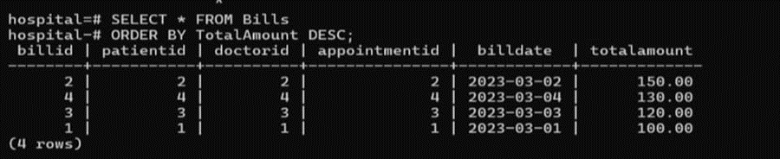
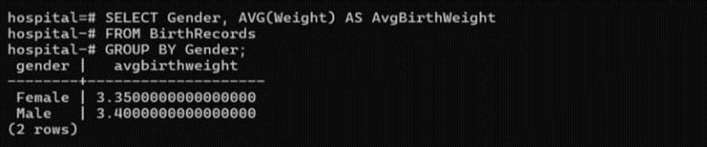
5. GROUP BY & ORDER BY :
List all patients ordered by their name in ascending order from Patient table.
Sort the total amount from bill table in descending order.
Group the birth records by gender and calculate the average birth weight for each gender.

Slide 20
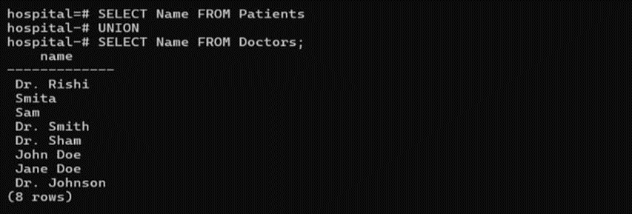
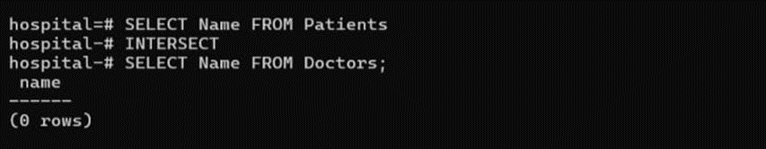
6. UNION , INTERSECT & MINUS:
Combine records from two tables, e.g , retrieve names of both patients and doctors.
Find patients and doctors who have the same name.

Slide 21
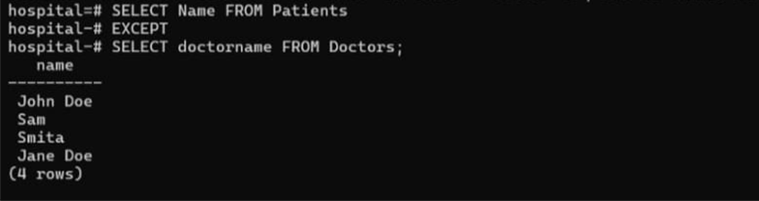
Find patients whose names are not listed as doctors.

Slide 22
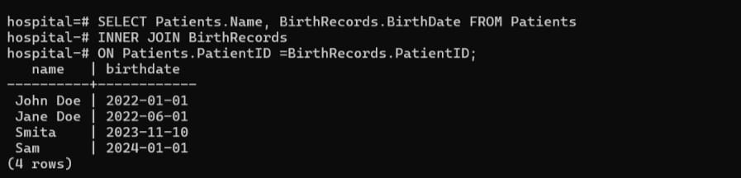
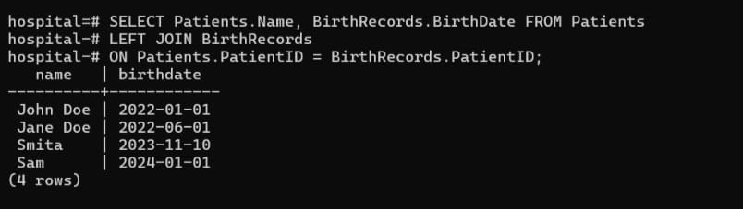
7. JOINS ( INNER , LEFT , RIGHT , FULL OUTER ) :
Retrieve patient names and birth dates for those who have a matching birth record.
Retrieve all patient names and their birth dates, including patients without birth records.

Slide 23
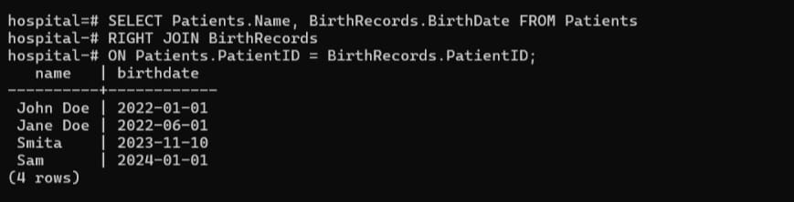
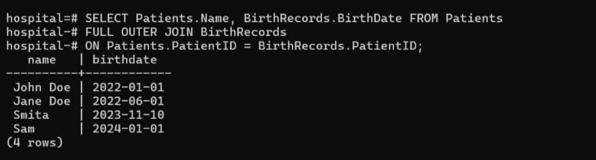
Retrieve all birth records and their corresponding patient names, including birth records without matching patients.
Retrieve all patient names and birth dates, including those without matches in either table.

Slide 24
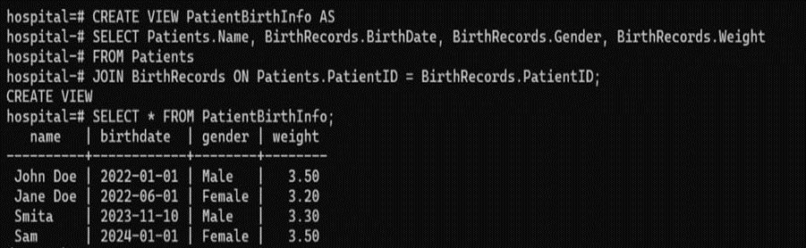
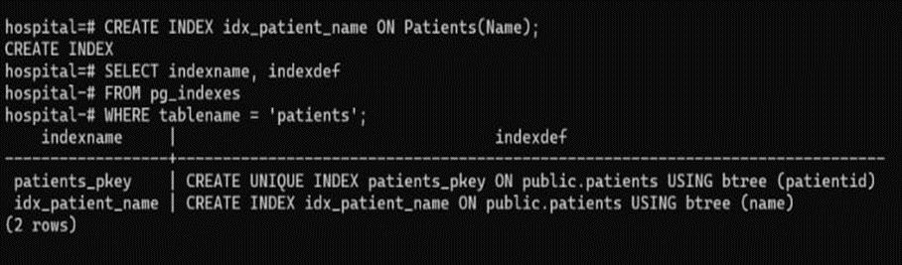
8. VIEWS :
Create a view that shows patient names, their birth details .
9. INDEXEX :
Create an index on the Patients table for faster searching by name.

Slide 25
CONCLUSION
Hence, we have successfully implemented the Hospital Management System (HMS), which helps in centralizing the data required for managing various tasks in a healthcare institution.
Hospital Management Systems have the ability to ease the workload of hospital staff and provide up-to-date information to healthcare professionals and administrative teams. It is crucial to organize the flow of information and present it in a way that can be easily accessed and acted upon by various departments within the hospital or associated medical facilities.
We have successfully implemented several functionalities, including patient record management, appointment scheduling, and billing processes, resulting in a fully functional database management system for hospitals. This ensures better coordination, enhanced healthcare delivery, and improved patient care.
Software Used : PostgresSQL
THANK YOU!

